Slide 1








GLOBAL ACADEMY OF TECHNOLOGY
An Autonomous Institute, Affiliated to VTU Belagavi, Approved by AICTE, Accredited by NAAC with "A" Grade, Ideal Homes Township, Rajarajeshwari Nagar, Bengaluru-560098
HACK-A-LEAGUE 4.0
# BEYOND INNOVATION
Project Title: EduTube
Team Name: 3 IDIOTS
Team Number: 56
Team Members: Sriram K N, M Vashishta Varma, Gireeshgowda K V
College Name: New Horizon College Of Engineering

Slide 2
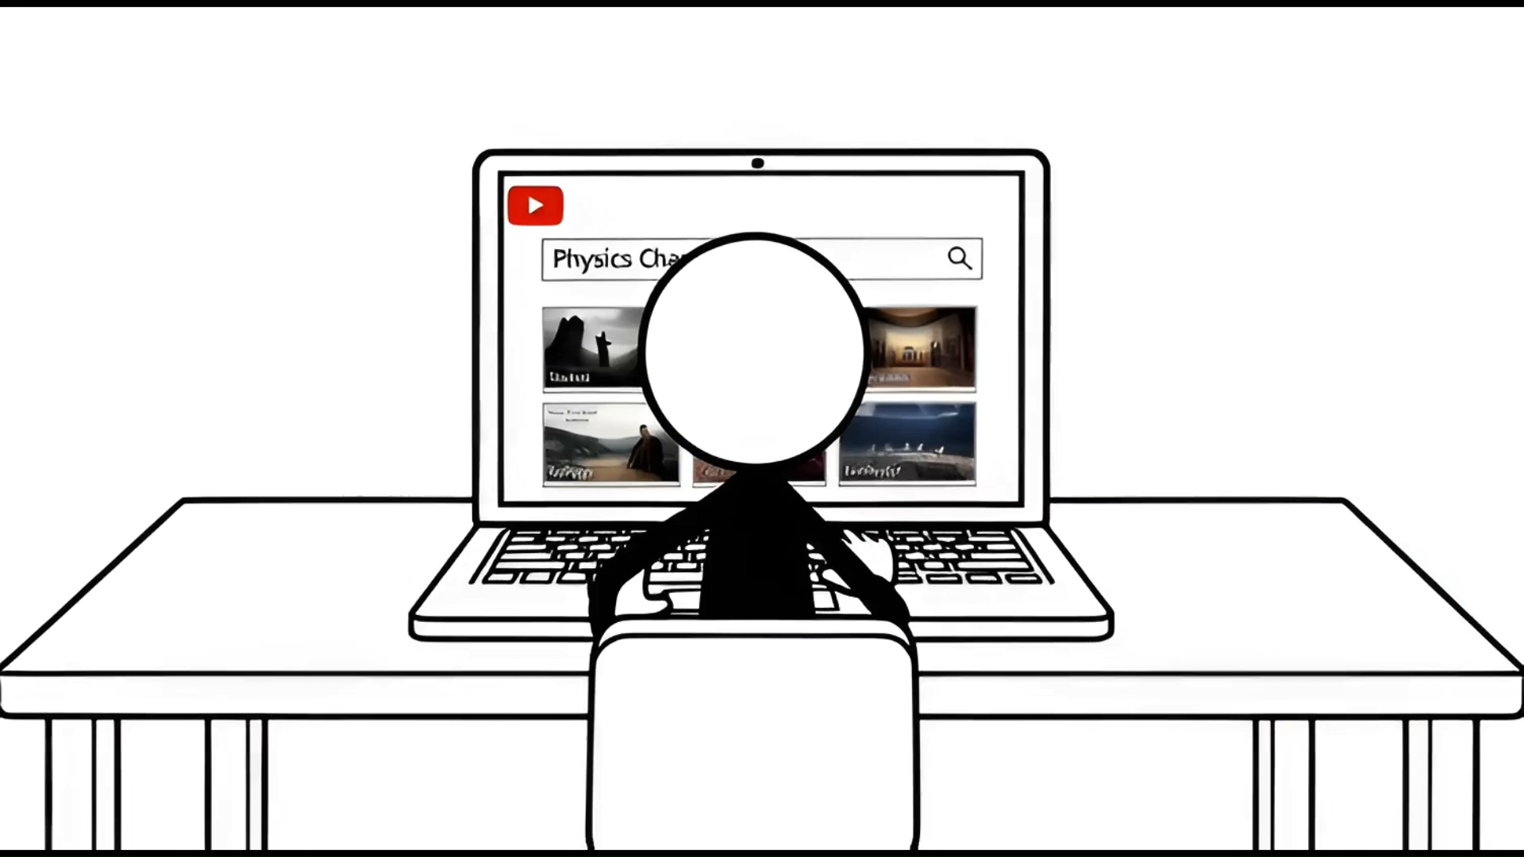

Slide 3
PROBLEM STATEMENT
Students increasingly use YouTube for learning, but the platform is designed for engagement and entertainment, leading to distractions from recommendations, shorts, and unrelated content. There is no structured way to take notes, track understanding, or collaborate while watching videos. This results in passive consumption, low retention, and inefficient learning.
The challenge is to transform YouTube into a focused, interactive learning environment by reducing distractions and integrating features like notes, AI assistance, quizzes, and collaboration without modifying YouTube’s core platform.
HACK-A-LEAGUE 4.0

Slide 4

SCOPE
2+ billion monthly active users use YouTube worldwide.
Over 1 billion hours of video are watched on YouTube every day.
A majority of users report using YouTube to learn new skills, academics, or tutorials (education is one of the top content categories).
We are not creating a new learning platform we are upgrading the world’s largest one.
HACK-A-LEAGUE 4.0

Slide 5
SOLUTION REVIEW
EduTube is a Chrome extension + Web Application that transforms YouTube into a focused, AI-powered learning platform without modifying YouTube itself. It removes distractions like recommendations and shorts, enabling a dedicated Study Mode for students.
Timestamp-based note-taking
AI chatbot powered by video transcripts
Automatic quiz generation
Smart playlist creation
Real-time collaboration
Unlike traditional learning platforms, EduTube leverages YouTube’s vast educational content and adds an intelligent learning layer on top of it, converting passive watching into structured, interactive, and collaborative learning.
HACK-A-LEAGUE 4.0

Slide 6
Frontend / Extension React (Chrome Extension UI) HTML, CSS, JavaScript Chrome Extension APIs Backend Fast API (Python) REST APIs JWT Authentication Database MongoDB
TECHNICAL APPROACH
External APIs
YouTube Data API (video metadata, thumbnails, duration)
YouTube Transcript API (transcripts, timestamps)
AI & Processing
Transcript-based Q&A logic
Quiz generation logic
Communication
HTTPS API calls (Extension ↔ Backend)
HACK-A-LEAGUE 4.0

Slide 7
IMPACT AND BENEFITS
Impact on Users
Converts YouTube into a focused learning platform.
Improves learning through notes, quizzes, and AI support.
Saves time by filtering relevant educational content.
Enables collaborative learning among students.
Social Benefits
Makes quality learning accessible to all.
Promotes productive and distraction-free screen usage.
Environmental Benefits
Supports digital learning and reduces use of physical resources.
Minimizes travel for coaching and classes.
HACK-A-LEAGUE 4.0

Slide 8
CONCLUSION
EduTube effectively addresses the problem of distraction and passive learning on YouTube by transforming it into a focused, interactive learning platform. By integrating features like study mode, notes, AI chatbot, quizzes, and collaboration, it promotes active and structured learning. The solution leverages existing YouTube content while adding an intelligent learning layer, making it practical and scalable. It can be expanded with advanced AI personalization, learning analytics, and instructor-led modes. With increasing reliance on video-based education, this approach has strong real-world applicability across schools, colleges, and online learning communities.
HACK-A-LEAGUE 4.0

Slide 9
Thank You
HACK-A-LEAGUE 4.0

